Slide 1
CMSC204
Kartchner
V(StateGraph) = {Oregon, Alaska, Texas, Hawaii, Vermont, NewYork, California}
E(StateGraph) = {(Alaska, Oregon), (Hawaii, Alaska), (Hawaii, Texas), (Texas, Hawaii), (Hawaii, California), (Hawaii, New York), (Texas, Vermont), (Vermont, California), (Vermont, Alaska)}
1. Draw the StateGraph
VT
AL
OR
NY
CA
TX
HI
{Oregon, Alaska, Texas, Hawaii, Vermont, New York, California}
{(Alaska, Oregon), (Hawaii, Alaska), (Hawaii, Texas), (Texas, Hawaii), (Hawaii, California), (Hawaii, New York), (Texas, Vermont), (Vermont, California), (Vermont, Alaska)}
No, there isn’t
Yes, there is
From Texas

Slide 2
a. Show the adjacency matrix that would describe the edges in the graph. Store the vertices in alphabetical order
States
AL CA HI NY OR TX VT
AL CA HI NY OR TX VT
0 0 0 0 1 0 0
0 0 0 0 0 0 0
1 1 0 1 0 1 0
0 0 0 0 0 0 0
0 0 0 0 0 0 0
0 0 1 0 0 0 1
1 1 0 0 0 0 0
3. b. Show the adjacency lists
that would describe the edges in the graph
AL CA HI NY OR TX VT
OR
AL
CA
NY
TX
VT
HI
AL
CA

Slide 3
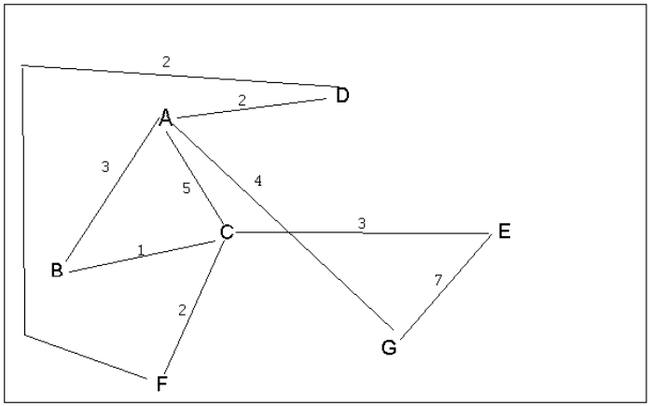
4 a. Which of the following lists the graph nodes in depth first order beginning with E?
A) E, G, F, C, D, B, A
B) G, A, E, C, B, F, D
C) E, G, A, D, F, C, B
D) E, C, F, B, A, D, G Answer: option C
4 b. Which of the following lists the graph nodes in breadth first order beginning at F?
A) F, C, D, A, B, E, G
B) F, D, C, A, B, C, G
C) F, C, D, B, G, A, E
D) a, b, and c are all breadth first traversals Answer: option A

Slide 4
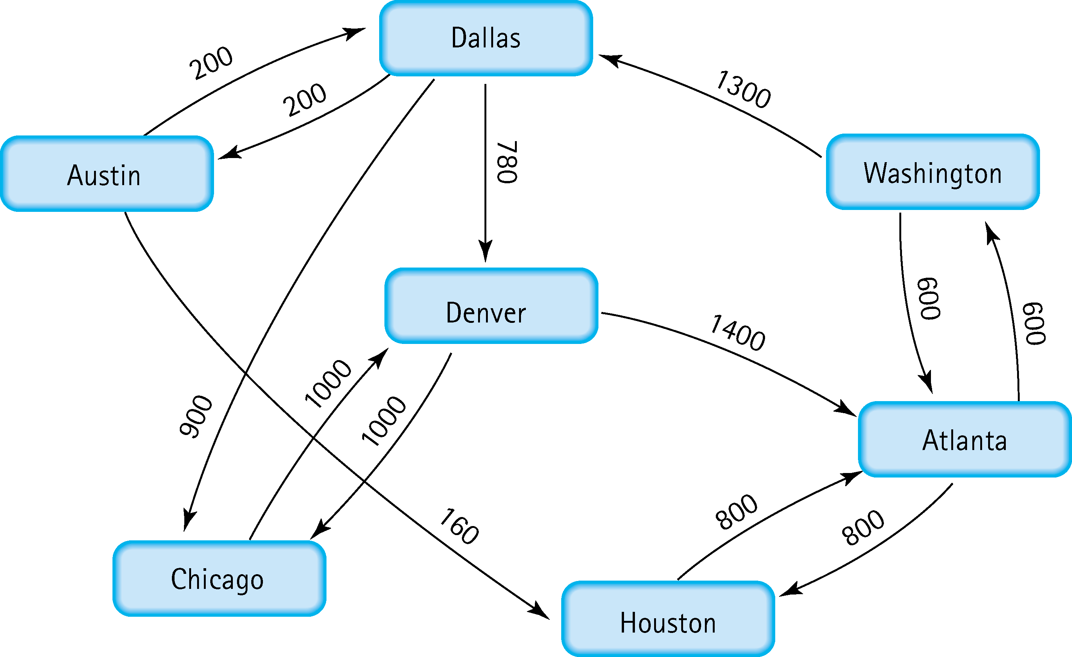
5. Find the shortest distance from Atlanta to every other city
From Atlanta to Austin is: 2100
From Atlanta to Chicago is: 2800
From Atlanta to Dallas is: 1900
From Atlanta to Denver is: 2680
From Atlanta to Houston is: 800
From Atlanta to Washington is: 600

Slide 5
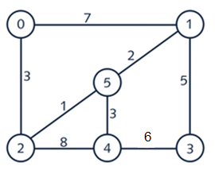
6. Find the minimal spanning tree using Prim’s algorithm. Use
0 as the source vertex . Show the steps.
Weight
2
5
1
4
3
3
1
2
3
5
0
1
5
2
4
3
V(T) = {0}
E(T) = { } → I added vertex(0)
N(T) = {1, 2, 3, 4, 5}
2) V(T) = {0, 2}
E(T) = {(0, 2)} → edge[3], vertex(2) to be added
N(T) = {1, 3, 4, 5}
3) V(T) = {0, 2, 5}
E(T) = {(0, 2) (2, 5)} → edge[1], vertex(5) to be added
N(T) = {1, 3, 4}
4) V(T) = {0, 1, 2, 5}
E(T) = {(0, 2) (2, 5) (5, 1)} → edge[2], vertex(1) to be added
N(T) = {3, 4}
5) V(T) = {0, 1, 2, 4, 5}
E(T) = {(0, 2) (2, 5) (5, 1) (5, 4)}
N(T) = {3} → edge[3], vertex(4) to be added
5) V(T) = {0, 1, 2, 3, 4, 5}
E(T) = {(0, 2) (2, 5) (5, 1) (5, 4) (1, 3)}
N(T) = { } → edge[5], vertex(3) to be added

Slide 6
7. Find the minimal spanning tree using Kruskal’s algorithm.
Show the weights in order and the steps.
0
1
5
2
4
3
0
1
Edge
Weight
Edge
Weight
5
0 - 1
0 - 2
1 - 3
1 - 5
2 - 4
2 - 5
3 - 4
4 - 5
7
3
5
2
8
1
6
3
2 - 5
1 - 5
0 - 2
4 - 5
1 - 3
3 - 4
0 - 1
2 - 4
1
2
3
3
5
6
7
8
2
4
3
0
1
5
2
4
3
0
1
0
1
5
5
2
4
3
2
4
3

Slide 7
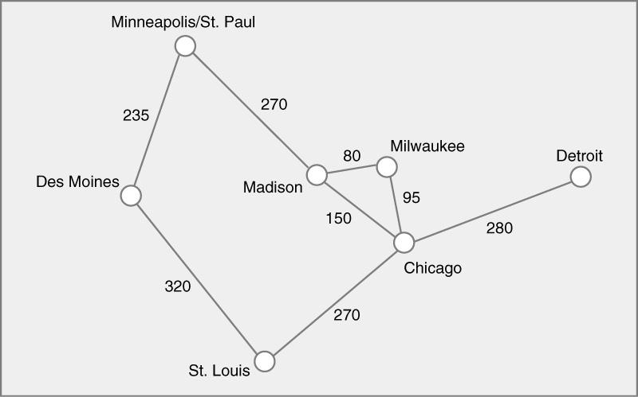
8. Find the minimal spanning tree using the algorithm you prefer. Use
Minneapolis/St. Paul as the source vertex
Edge
Weight
Edge
Weight
0 - 1
0 - 3
1 - 2
2 - 5
3 - 4
3 - 5
4 - 5
5 - 6
235
270
320
270
80
150
95
280
3 - 4
4 - 5
3 - 5
0 - 1
0 - 3
2 - 5
5 - 6
1 - 2
80
95
150
235
270
270
280
320
V(T) = {0, 1, 2, 3, 4, 5, 6}
E(T) = {(0, 1) (0, 3) (3, 4)
(4, 5) (5, 2) (5, 6)}

Slide 8
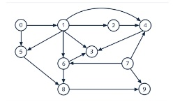
9. List the nodes of the graph in a breadth first topological ordering. Show the
steps using arrays predCount, topologicalOrder and a queue
1 > 7 > 1 > 2 > 5 > 6 > 4 > 8 > 3 > 9
[0] [1] [2] [3] [4] [5] [6] [7] [8] [9]
predCount 0 Topological Order
Queue
predCount 1
predCount 2
predCount 3
predCount 4
0[ [1[ [1[ [3[ [3[ [2[ [2[ [0[ [2[ [2
0[ [7[ [1[ [2[ [5[ [6[ [4[ [8[ [3[ [9
0[ [7[ [1[ [2[ [5[ [6[ [4[ [8[ [3[ [9
0[ [0[ [1[ [3[ [2[ [1[ [1[ [0[ [2[ [1
0[ [7[ [0[ [2[ [1[ [0[ [0[ [8[ [2[ [1
0[ [7[ [1[ [1[ [0[ [6[ [4[ [8[ [0[ [1
0[ [0[ [0[ [0[ [0[ [0[ [0[ [0[ [0[ [0

Slide 9
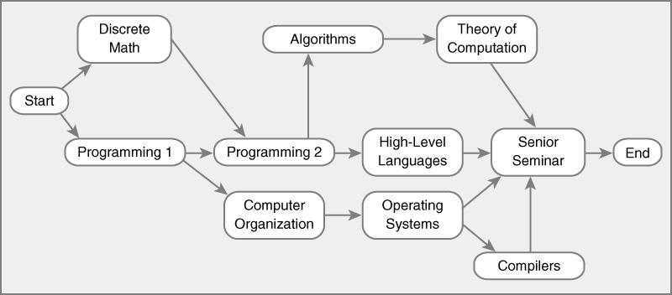
10. List the nodes of the graph in a breadth first topological ordering.
Start > Decrete Math > Programming 1 > Programming 2 > Computer Organization > Algorithms > Operating Systems > High Level Language > Theory Of Computation > Compilers > Senior Seminar > End
[0] [1] [2] [3] [4] [5] [6] [7] [8] [9]
predCount 0 Topological Order
Queue
predCount 1
predCount 2
predCount 3
predCount 4
predCount 5
0[ [1[ [1[ [2[ [1[ [1[ [1[ [1[ [1[ [4 [ 1[[1
S
DM
P1
P2
CO
A
OS
HLL
TC
C
SS
E
S
DM P1
P2
CO
A OS HLL
TC C
SS
E
0[ [0[ [0[ [2[ [1[ [1[ [1[ [1[ [2[ [4 1[ [1
0[ [7[ [0[ [0[ [0[ [1[ [1[ [1[ [1[ [4 1[ [1
0[ [7[ [1[ [0[ [0[ [0[ [0[ [0[ [1[ [4 1[ [1
0[ [7[ [1[ [0[ [0[ [0[ [0[ [0[ [0[ [2 0[ [1
0[ [0[ [0[ [2[ [1[ [1[ [1[ [1[ [2[ [0 1[ [1

